Slide 1
Module 01 ”Introduction to C#, .NET and VS”

Slide 2
Agenda
C# and The .NET Framework
Anatomy of a C# Program
Basic Input and Output in C#
Best Practices

Slide 3


Compilation and Execution
The compilation and execution happen in multiple steps
class Program
{
static void Main()
{
}
}
IL Compiler
.method private hidebysig static void Main() cil managed {
.maxstack 8
IL_0001: call void
IL_000d: ...
}
C#
IL
CLR
09 87 fE 99 AD D9 C4 28 77 59 88 EF AF DD 00 00 74 C3 C9 88 11 59 29 FF FF 49 9F AA 88 99 24 AD D9 C4 28 77 59 88 EF AF DD 00 27 61 41 4F 2E 29
JIT Compiler
Native
Notes:
Explain all steps of the above processes.
Highlight what happens when in the process.
IL compilation
Just-in-time compilation
Running in bootstrapped .NET wrapper
Mention that a lot of the things happen without the user/developer noticing it.
User must have .NET Framework installed to run .NET windows applications.
Important fact to stress: (MS)IL is what the languages share and provide a uniform entry point to objects and values.

Slide 4
.NET Programming Languages
C#
VB.NET
C++/CLI
F#
Third-party languages
Notes:
Walk through each – expanding upon which language is good for what.
Drop by http://www.dotnetlanguages.net .

Slide 5
The C# Language
The language for the .NET Framework!
New and very powerful object-oriented language inspired by C, C++, and Java
C/C++ syntax
Java paradigms
Type-safe, easy-to-use, and very elegant
Created exclusively for the .NET Framework by Anders Hejlsberg
Evolves all the time with the trends of the development community
Notes:
Explain the story of C#
Why is it called C#
The CV of Anders Hejlsberg
Stress that C# keeps evolving rapidly!

Slide 6
The Evolution of .NET and C#
Major .NET and C# releases
Year | .NET | Visual Studio | C#
2002 | 1.0 | Visual Studio .NET | 1.0
2003 | 1.1 | Visual Studio 2003 | -
2005 | 2.0 | Visual Studio 2005 | 2.0
2006 | 3.0 | - | -
2007 | 3.5 | Visual Studio 2008 | 3.0
2010 | 4.0 | Visual Studio 2010 | 4.0
2012 | 4.5 | Visual Studio 2012 | 5.0
https://docs.microsoft.com/en-us/dotnet/csharp/whats-new/csharp-version-history
Notes:
These are the major releases.
There are also service packs etc. but they are left out
Explain the philosophy of Microsoft, that they are very open regarding releases and alpha/beta/CTP downloads.

Slide 7
Agenda
C# and The .NET Framework
Anatomy of a C# Program
Basic Input and Output in C#
Best Practices

Slide 8
“Hello, World” in C#
using System;
namespace SimpleCSharpApp
{
class Program
{
static void Main(string[] args)
{
Console.WriteLine( "Hello, World from C#" );
}
}
}

Slide 9
Basic Structure
A C# application can consist of many files, usually .cs-files
A C# program consists of classes, structures, and other types
The ‘{’ and ‘}’ characters are the foundational block delimiters
The ‘;’ character separates statements of the language, if needed
A class is a unit of data members and “methods”
Classes will be treated in much more details later
Notes:
As opposed to e.g. Java, the name of the C#-file is not important!
Unlike e.g. C++ there are no header files

Slide 10

The Main() Method
The Main() method has a special meaning
When the program starts, Main() is executed
When Main() finishes execution, the program terminates
Multiple classes can each have a Main() method
Designate a unique Main() as the entry point
Declare Main() to be static void Main
Note that C# is
Case-sensitive!
Whitespace-insensitive!
Notes:
At this point create a demonstration:
Open HelloWorld.cs in VS 2012
Show case-sensitive
Show whitespace-insensitive
Show how VS will nicely reformat the code, if necessary
When you have discussed the “Namespace and Using” slide, continue this demonstration by showing equality by rectangularly cutting out the “System.” blocks and replacing them with a single “using System;”

Slide 11
Namespaces and using
.NET comes equipped with thousands of classes organized into namespaces
System is the main namespace with core functionality
Classes are referred to by their namespace
Using statements brings classes into scope
System.Console.WriteLine( "Hello, World from C#" );
using System;
Console.WriteLine( "Hello, World from C#" );
Notes:
“Using” is not like the Java.style “include”, but more like an “Import”.

Slide 12
Creating a C# Project in Visual Studio
Projects and Solutions in Visual Studio
Solution Explorer
Solutions
Projects
Files
A brief overview of Visual Studio features and contents
Common development environment for
Programming languages
Project types
Data sources
…
Compiling a simple C# program
Locating errors
Running programs with or without the Visual Studio debugger
Notes:
Intellisense
CTRL+Å

Slide 13
Agenda
C# and The .NET Framework
Anatomy of a C# Program
Basic Input and Output in C#
Best Practices

Slide 14
Introducing the System.Console Class
Appropriate for “Console Applications”
Write output to the screen by
Console.Write()
Console.WriteLine()
These methods are overloaded
Read from the keyboard via
Console.Read()
Console.ReadLine()
Console in fact supports colors!

Slide 15
Formatting Console Output
Use {0}, {1}, {2} etc. as placeholders for Console.WriteLine()
Console.WriteLine(
"My favorite number is {0}. Not {1}",
87, 42
);
My favorite number is 87. Not 42

Slide 16
Formatting Numerical Data
The placeholder can be further refined by
‘C ‘or ‘c’ Currency
‘D’ or ‘d’ Decimal numbers
‘E’ or ‘e’ Exponential notation
‘F’ or ‘f’ Floating point
‘N’ or ‘n’ Number
‘X’ or ‘x’ Hexadecimal
Precision of formatting can be specified after the format character
Strings can be formatted in a similar fashion using string.Format()
Console.WriteLine(
"My favorite number
is {0:x}",
87);
My favorite number is 57
Console.WriteLine( "Pi is {0:f2}", Math.PI );

Slide 17
Agenda
C# and The .NET Framework
Anatomy of a C# Program
Basic Input and Output in C#
Best Practices

Slide 18
Comments
Remember to write your comments when you write your code!
Single-line comments
Multi-line comments
// Input the user’s name
Console.WriteLine( "Please input your name: " );
string name = Console.ReadLine();
/* In the section below, we iterate through the list of all the elements. We then compute their values one-by-one before returning the overall value */
DoStuff();

Slide 19
XML Documentation
Use /// to generate XML comments
/// <summary>
/// This is an example program for use with
/// the “Programming in C# 5.0" course.
/// </summary>
class Program
{
/// <summary>
/// This is the entry point of the application.
/// </summary>
/// <param name="args">Command-line arguments
/// supplied to the application</param>
static void Main( string[] args )
{
Console.WriteLine( ... );
}
}

Slide 20
The Integrated .NET Framework Documentation System
Extremely valuable documentation while programming
A must to use for any programmer!
“HELP” menu item in Visual Studio
Press F1 on C# keyword or .NET type

Slide 21
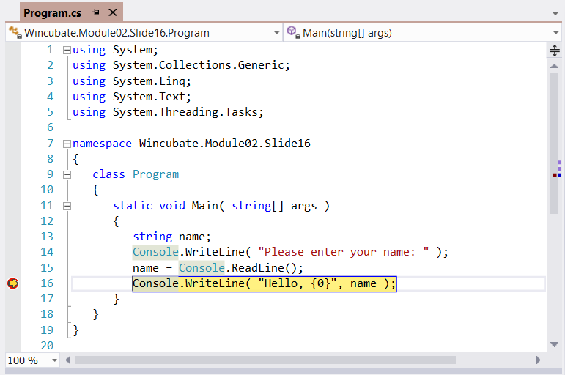
Using the Visual Studio Debugger
Notes:
Set breakpoints in code
Step through program execution
Use the visualizing tools in the Debugger (mouse-over)
Set watches
Stop, modify a run-time value, continue execution
Lav en exception!

Slide 22
Customizing Visual Studio
Tools -> Options
Millions of commands and shortcuts
Shortcuts can be (re)defined at will
Customizations
Code Snippets
Extensions and Updates
Reset everything(!) with
devenv /ResetSettings

Slide 23
Summary
C# and The .NET Framework
Anatomy of a C# Program
Basic Input and Output in C#
Best Practices

Slide 24
Question
What will be written to the Console when executing the following statements? string s = "\"Hello\""; Console.WriteLine( @"{0}, {1}", s, "world!" );
Compile-time error
Runtime error
"Hello", world!
\"Hello\", world!

